Slide 1
CISC Homework 5 Convert NFA to DFA
Tianxiang Jin
tjin@my.harrisburgu.edu

Slide 2
Overview
Non-deterministic Finite Automata (NFA) is a finite automaton that for some single input and given state, the machine could potentially go to more than 1 states, i.e. under these cases, the transform could not be uniquely determined by the given input symbol and input state
Deterministic Finite Automata (DFA) is a finite automata where a specific given input symbol and input state, the output state could always be explicit determined by the transfer diagram and rules.
In the homework, we will analyze a program that can convert a NFA into a DFA

Slide 3
Representation
We can give representation of an NFA machine as follows:
N = {Q, ∑, δ, q0, F}, where:
Q – Set of finite non-empty states
∑ -- Set of finite non-empty input symbols
δ – The transitional function of NFA
q0 – Set of beginning states
F – Set of final (terminal) states
Example of an NFA Machine
0
0, 1
1
q0
q1
1

Slide 4
Steps for Converting NFA to DFA
Assume our output DFA as D = {Q’, ∑, δ’, q0, F}
Step 1 – Start with set Q’ as ɸ (empty set)
Step 2 – Add the start state q0 to Q’, then find the transitions from this start state
Step 3 – In Q’, find the possible set of states for each valid input symbol. If the newly formed set of states is not in Q’ yet, we add it to Q’
Step 4 – Using transition function of NFA to find new possible set of states
Step 5 – In DFA, the final state will be all the states which contain F (the final states of NFA)
Step 6 – Remove those states that couldn’t be reached from DFA

Slide 5
Walkover Steps with an Example
Solution:
Start with empty Q’, we shall add the start state q0 into Q’.
From q0, we can construct the following transition table.
State\Symbol | 0 | 1
-> q0 | {q0, q1} | {q1}
*q1 | ɸ | {q0, q1}
0
0, 1
1
q0
q1
Since we get the transition diagram δ’ for state q0, we check and found a newly formed states set {q0, q1}. And we should add it into Q’.
We then add transition diagram for q1 and {q0, q1} to Q’
1
State\Symbol | 0 | 1
-> q0 | {q0, q1} | {q1}
*q1 | ɸ | {q0, q1}
*{q0, q1} | {q0, q1} | {q0, q1}

Slide 6
Walkover Steps with an Example - Continue
Please note we mark the final states with * mark. As in the given NFA, q1 is the final state, the in the output DFA, whenever a states set including q1, we should also set it as a final state.
Hence, in the output DFA here, the final states are q1 and {q0, q1}, with the transition relation δ’ as table in previous page.
The final transition diagram looks like follow, and this is the destination DFA we will output.
0
0, 1
1
q0
q1
1
0, 1
[q0]
[q0, q1]
0
Here we update state in DFA with “[]” because these states are newly formed states in DFA: A = [q0], B = [q1],
C = [q0, q1]. Thus, we could also use A, B and C to represent states in the DFA
1
1
[q1]

Slide 7
Algorithms to Implement the Conversion
We will use python to implement the NFA to DFA conversion
In our implementation, we will not consider ∈ (null) transition
Input format will be a csv file with NFA fields N = {Q, ∑, δ, q0, F}
Output format will be a separate csv file with DFA fields D = {Q’, ∑, δ’, q0, F}
Please find separate txt file with python code, please run it as .py

Slide 8
Example Input and Output 1
{
"nfa_states": 3,
"nfa_symbols": ["a", "b"],
"sigma_function": [[0, "a", [0, 1]], [0, "b", [0]], [1, "b", [2]]],
"start_state": 0,
"final_state": [2]
}
Input NFA Diagram
Output DFA Diagram
a,b
b
a
q1
[q0, q1]
b
q0
q2
q0
[q0, q2]
a
b
a
a
b

Slide 9
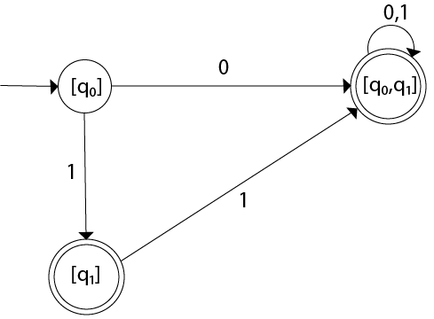
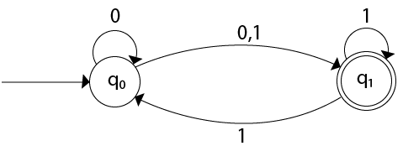
Example Input and Output 2
{
"nfa_states": 2,
"nfa_symbols": ["a", "b"],
"sigma_function": [[0, "a", [0, 1]], [0, "b", [1]], [1, "b", [0, 1]]],
"start_state": 0,
"final_state": [1]
}
Output DFA Diagram
Input NFA Diagram

Slide 10
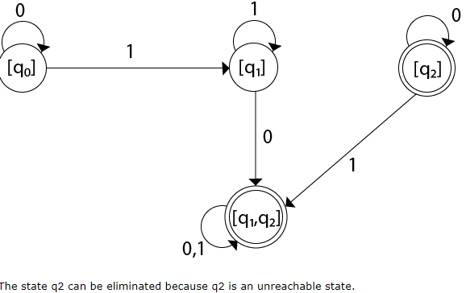
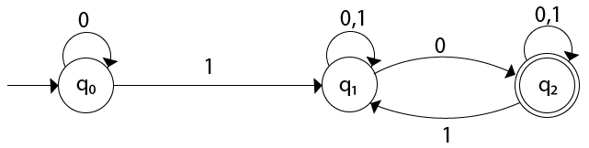
Example Input and Output 3
{
"nfa_states": 3,
"nfa_symbols": ["a", "b"],
"sigma_function": [[0, "a", [0]], [0, "b", [1]], [1, "a", [1, 2]], [1, "b", [1]], [2, "a", [2]], [2, "b", [1, 2]]],
"start_state": 0,
"final_state": [2]
}
Output DFA Diagram
Input NFA Diagram

